Slide 1



ACCOUNTING:
WHAT IT IS, ISN’T & WHY IT’S
WAY MORE THAN MATH!

Slide 2


WHAT IS ACCOUNTING?
Accounting is the language of business. Accountants know how businesses work, how they function and how they present themselves to the world... through their financial statements.

Slide 3

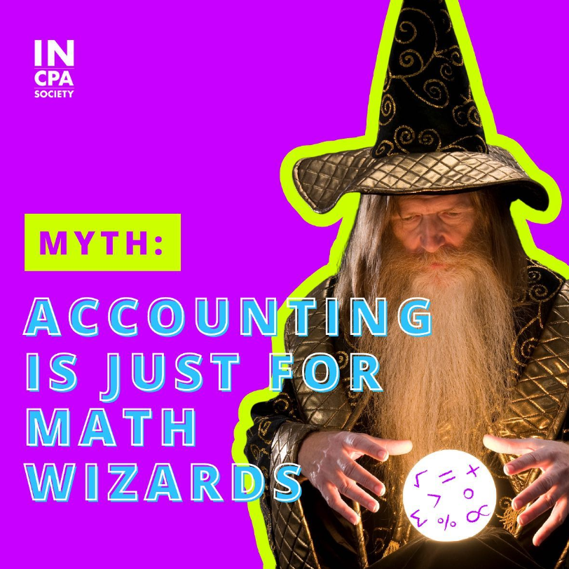

Slide 4



REALITY:
IF YOU CAN ADD, SUBTRACT, MULTIPLY & DIVIDE, YOU’RE GOOD!
BASIC MATH SKILLS
Accounting isn’t about being the best math wiz, accounting is about interpreting what numbers and data say. The majority of the math accountants use is basic math with the help of a calculator!

Slide 5
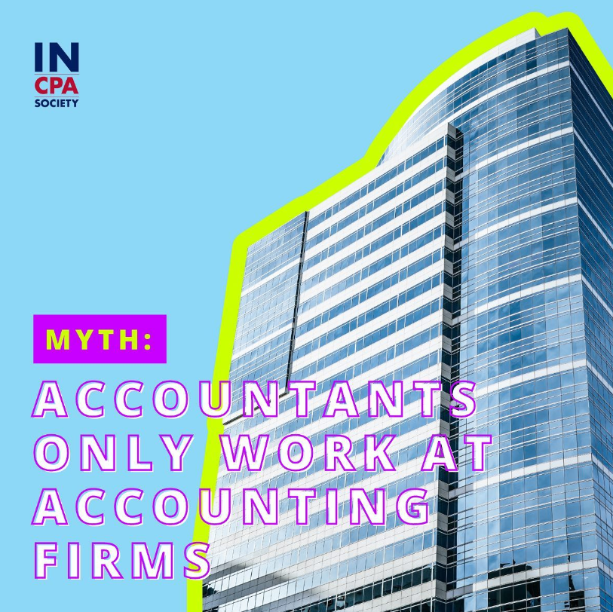
MYTH:

Slide 6


REALITY:
EVERY
BUSINESS NEEDS
ACCOUNTANTS
WORK ANYWHERE
Accountants have the unique ability to work in any industry they are interested in because every business needs an accountant.
Interested in sports, the Pacers need accountants. Want to work in healthcare? Accountants are needed at hospitals!

Slide 7
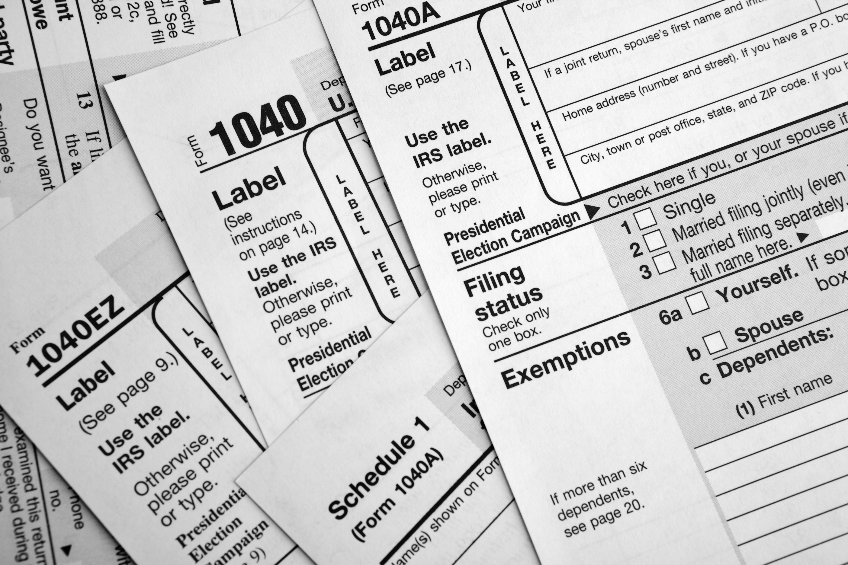
MYTH
:
ACCOUNTANTS
JUST DO TAXES

Slide 8

REALITY:
MANY
ACCOUNTANTS
NEVER TOUCH A TAX RETURN
TAX, NOT EVERYONE!
While some accountants and CPAs DO work on taxes, many never touch a tax return that isn’t their own. Instead they work on budgets, analysis, strategy and more. Basically, there’s a place and path for you in the profession that can meet your interests!

Slide 9
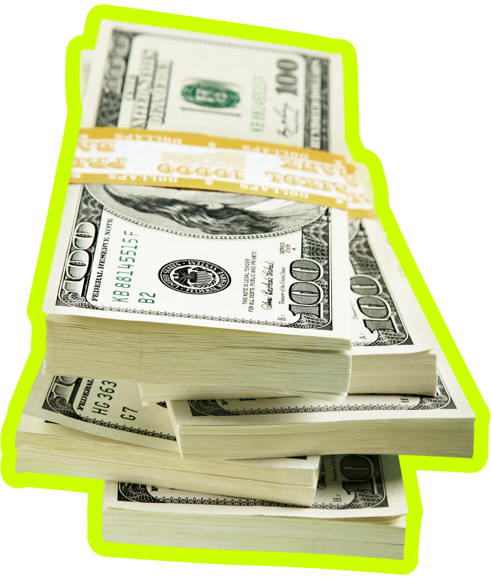
:
MYTH
ACCOUNTANTS HAVE LOW EARNING POTENTIAL

Slide 10

REALITY:
MAKE 6 FIGURES EARLY ON
ACCOUNTANTS
HAVE
UNLIMITED
EARNING
POTENTIAL
Not only can you make a great living, the accounting profession is known to be one of the most stable careers.
Even accounting interns are making bank? Many accounting interns are making $25+ an hour (as college students)
Corporate:
  Staff Accountant: $61,614-$90,708
  Finance Director: $127,546-$226,917
  CFO: $201,824-$478,153
Public:
  Tax Associate: $55,513-$71,728
  Audit Manager: $89,672-$140,173
  Partner: $162,630-$329,909
2024 Robert Half Salary Guide

Slide 11

MYTH
:
INTROVERTS
MAKE BETTER ACCOUNTANTS

Slide 12


REALITY:
ALL PERSONALITY
TYPES CAN THRIVE IN ACCOUNTING
Are you a...
REALIST? DREAMER?
IDEALIST? SEEKER?

Slide 13


REALITY:
ALL PERSONALITY
TYPES CAN THRIVE IN ACCOUNTING
What type of accountant are you? Take the quiz:

Slide 14

MYTH
:
ACCOUNTANTS
ARE STUCK IN THEIR OFFICE

Slide 15

REALITY:
MANY
ACCOUNTANTS HAVE TRAVEL OPPORTUNITIES

Slide 16



WHAT CAN ACCOUNTANTS DO?

Slide 17





CPA WEEK PRESENTER
ACCOUNTANT
A LITTLE ABOUT ME...
Where I work
What I do
Where I went to school
My favorite part about my job
The skills I use most in my job
What surprises me most about my job

Slide 18

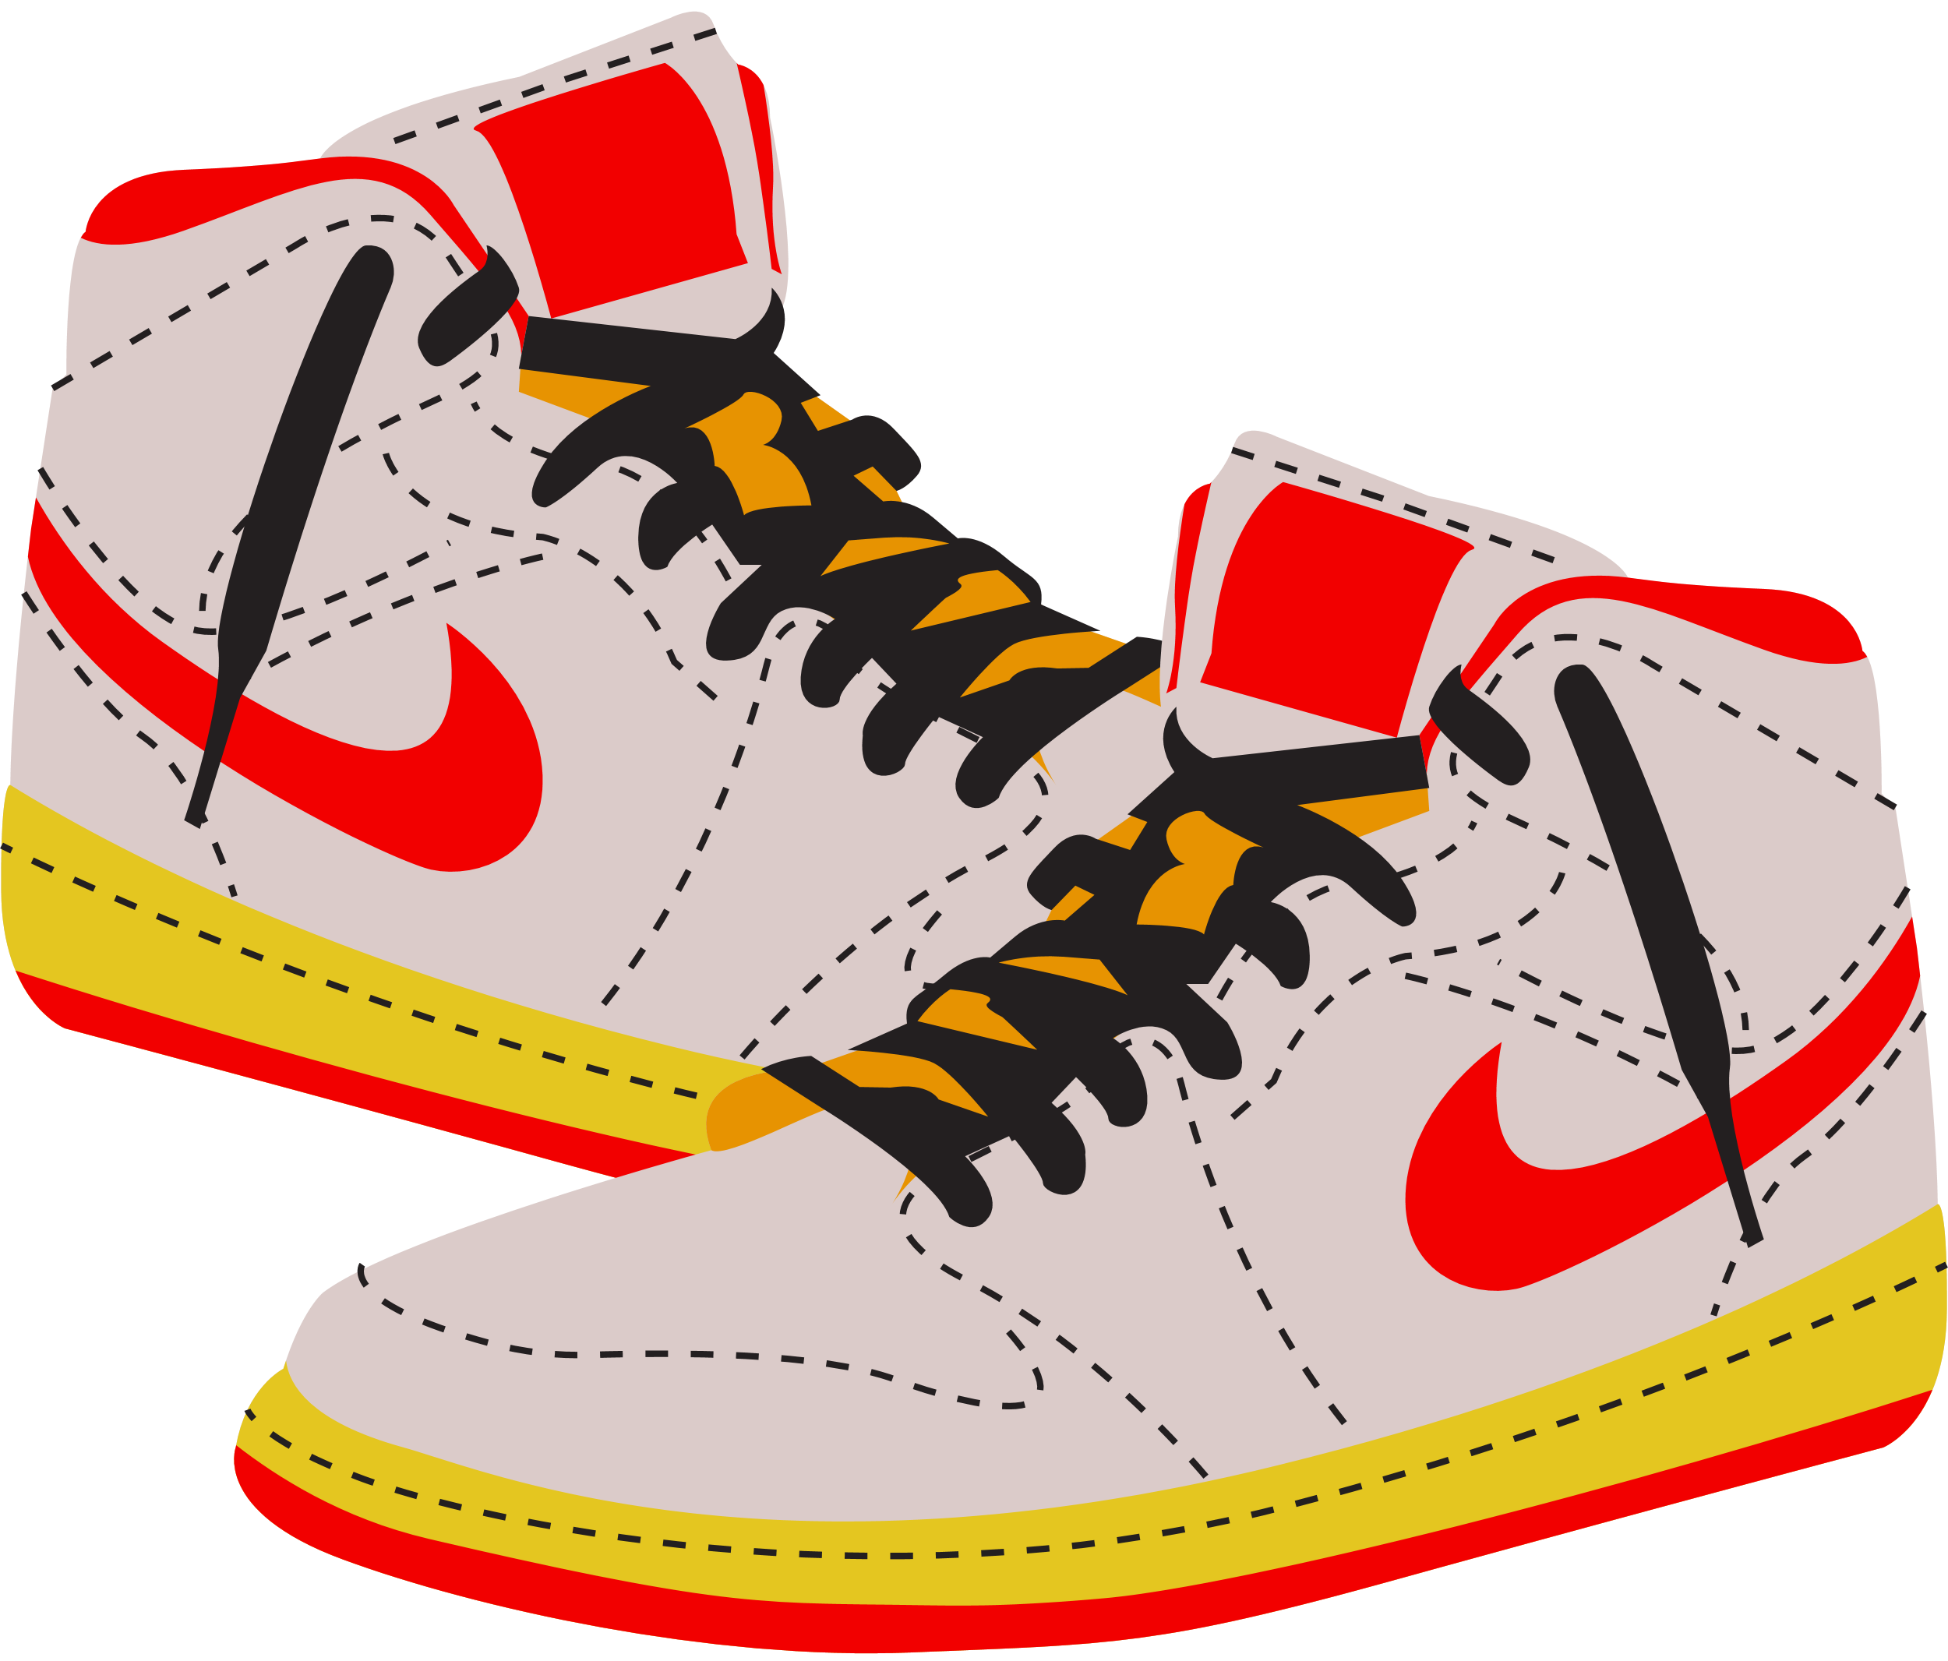

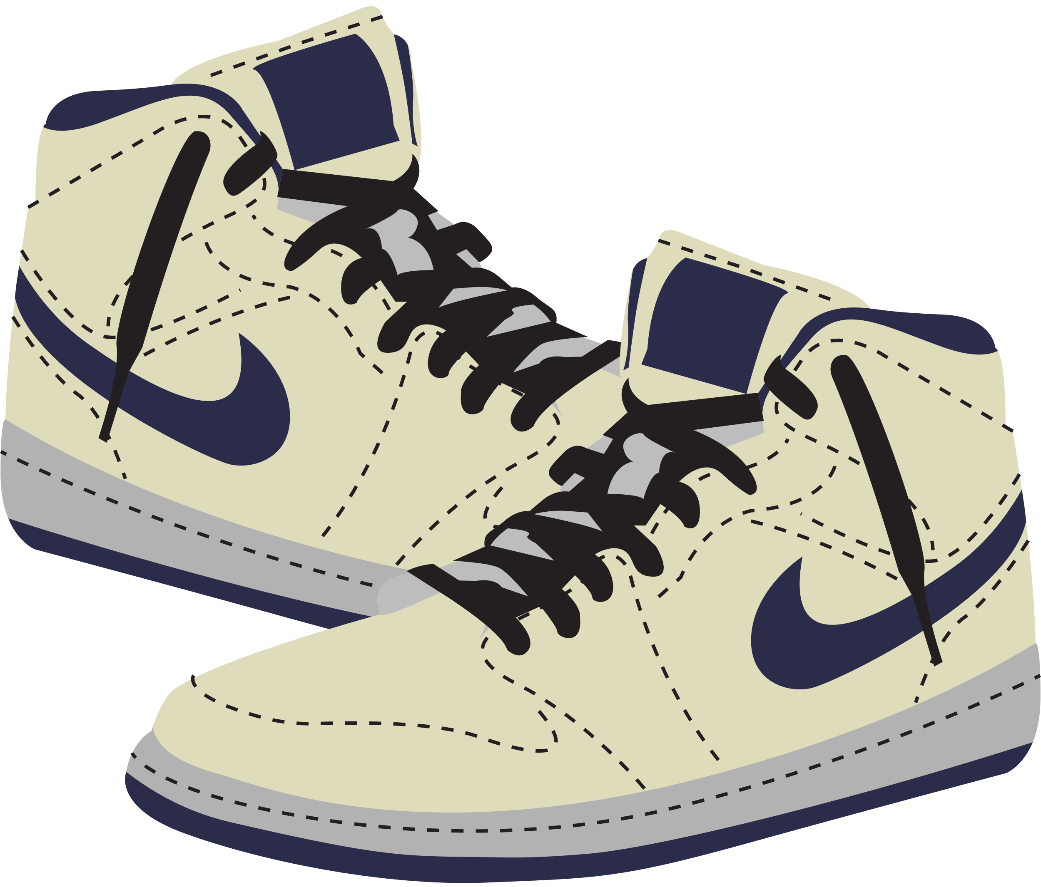




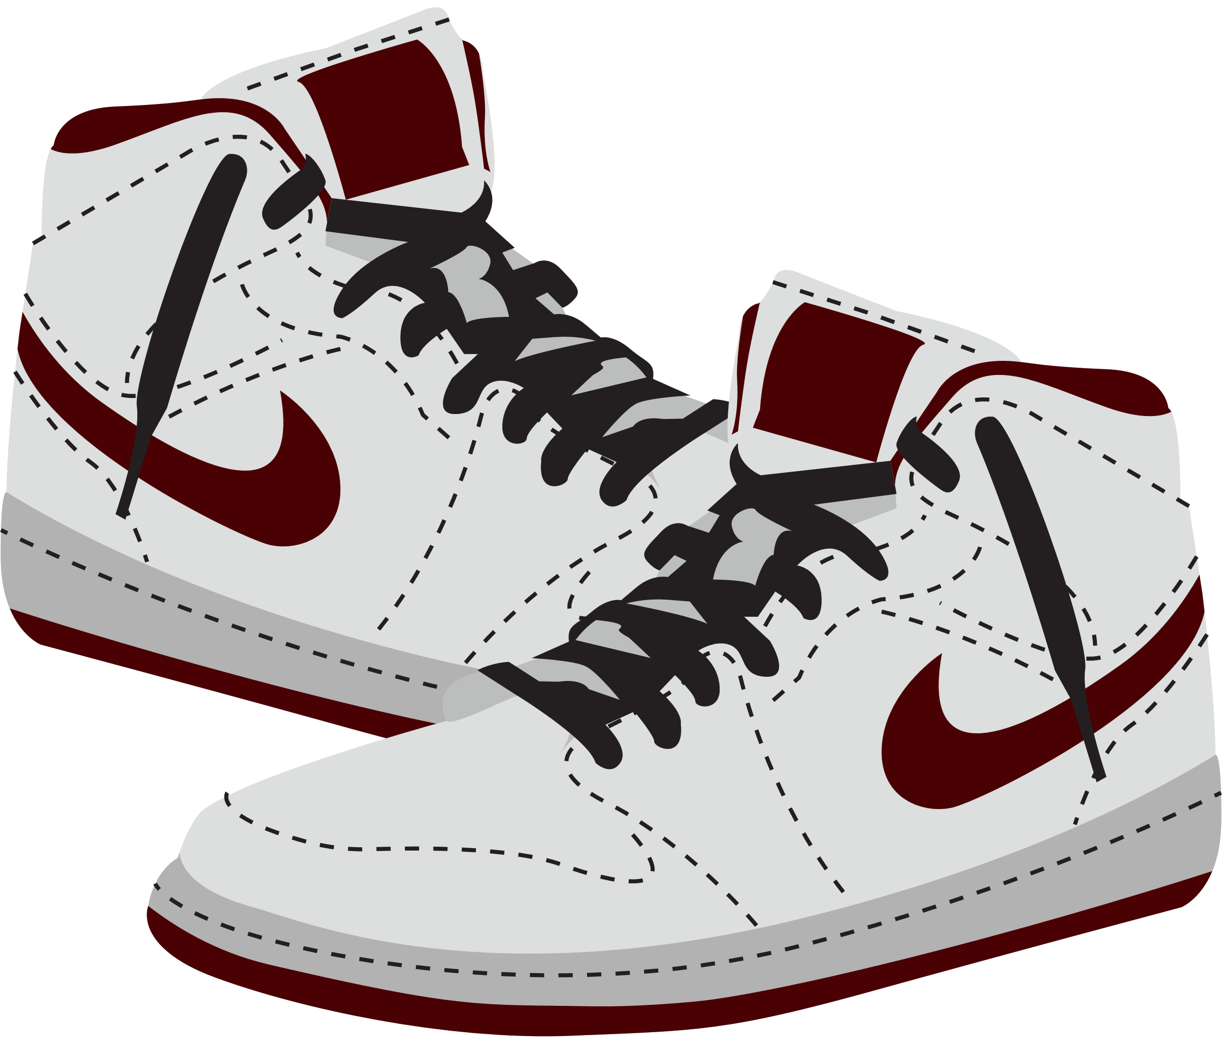
BUSINESS OWNER
The founder of Nike, Phil Knight Studied accounting & was a CPA!
ENTREPRENEUR
RUN YOUR OWN BUSINESS
Because accounting is often considered the language of business, there's something about a career in accounting that makes owning your own business more attainable.
Accounting is like boot camp for entrepreneurs, understanding how money works, where it goes is critical for business owners.

Slide 19
BUSINESS OWNER
Estimated net worth:
$47.7 billion
AKA... the 24th richest person in the world!
ENTREPRENEUR
RUN YOUR OWN BUSINESS
Because accounting is often considered the language of business, there's something about a career in accounting that makes owning your own business more attainable.
Accounting is like boot camp for entrepreneurs, understanding how money works, where it goes is critical for business owners.

Slide 20
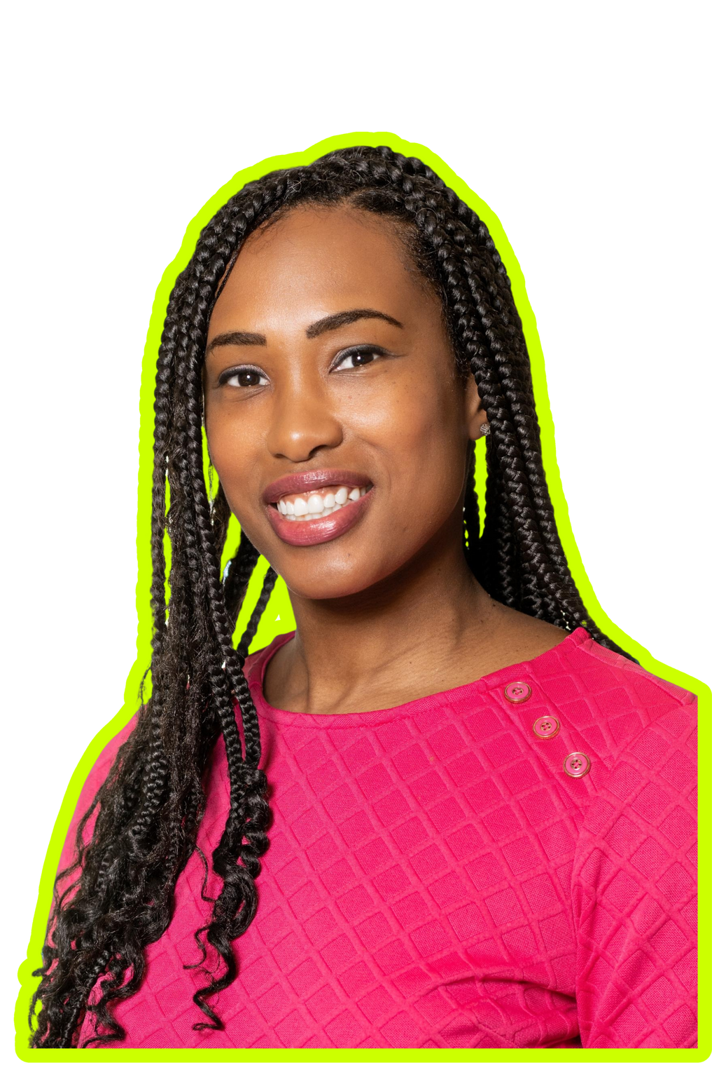


COMMUNITY LEADER
NOT-FOR-PROFIT
HELP YOUR COMMUNITY
Not-for-profit organizations need funding, planning, and allocation of resources to operate and help members of our communities.
Perks: Work with organizations that are making a difference, be a part of something bigger and do what you love using skills that suit you.
Jessica McClain, CPA
CFO | Girls Scouts Nation’s Capital

Slide 21






EARTH LOVER
ESG:
ENVIRONMENTAL, SOCIAL & (CORPORATE) GOVERNANCE
MAKE AN IMPACT
As companies are starting to take a more significant look at how their business impacts the environment. Accountants are becoming a popular choice to help analyze and report on these ESG (environmental, social and governance) areas.
You can help companies think about their impact with your accounting skills!

Slide 22


FRAUD DETECTOR
FBI employs
2,000+
accounting
special agents
FORENSIC ACCOUNTING
SOLVE FINANCIAL CRIMES
Forensic accountants are responsible for following the money and helping solve financial mysteries.
Perks: Work with organizations to help minimize and prevent loss, use your inquisitive skills, help catch the 'bad guys'.

Slide 23


RESOURCES TO LEARN MORE ABOUT ACCOUNTING

Slide 24


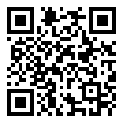

ACCOUNTING+
JOIN ACCOUNTING+
  Learn about the education needed to become an accountant, their lifestyles and careers.
  Access to scholarships and internships.
  Quizzes and resume templates.
  Awesome videos!
more resources

Slide 25




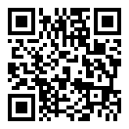
DAY IN THE LIFE VIDEOS:
youtube.com/@accounting_plus
more videos!

Slide 26
QUESTIONS?

